Slide 1
Amazon E-Commerce Analysis
Submitted by: Akhil Chauhan

Slide 2

Agenda
Problem Statement
Data Description
Data Cleaning & Preparation
Data Modeling
Key Metrics and Insights
Recommendations

Slide 3

Problem Statement
You are working as a business analyst at Amazon, a company currently performing well. The stakeholders wish to maintain this level of performance and seek improvement. For this purpose, they want to devise new strategies. You are part of a team exploring new ways to benefit customers, such as offering more discounts and Prime membership perks. Could you suggest additional methods to identify and reward customers and enhance their shopping experience?

Slide 4
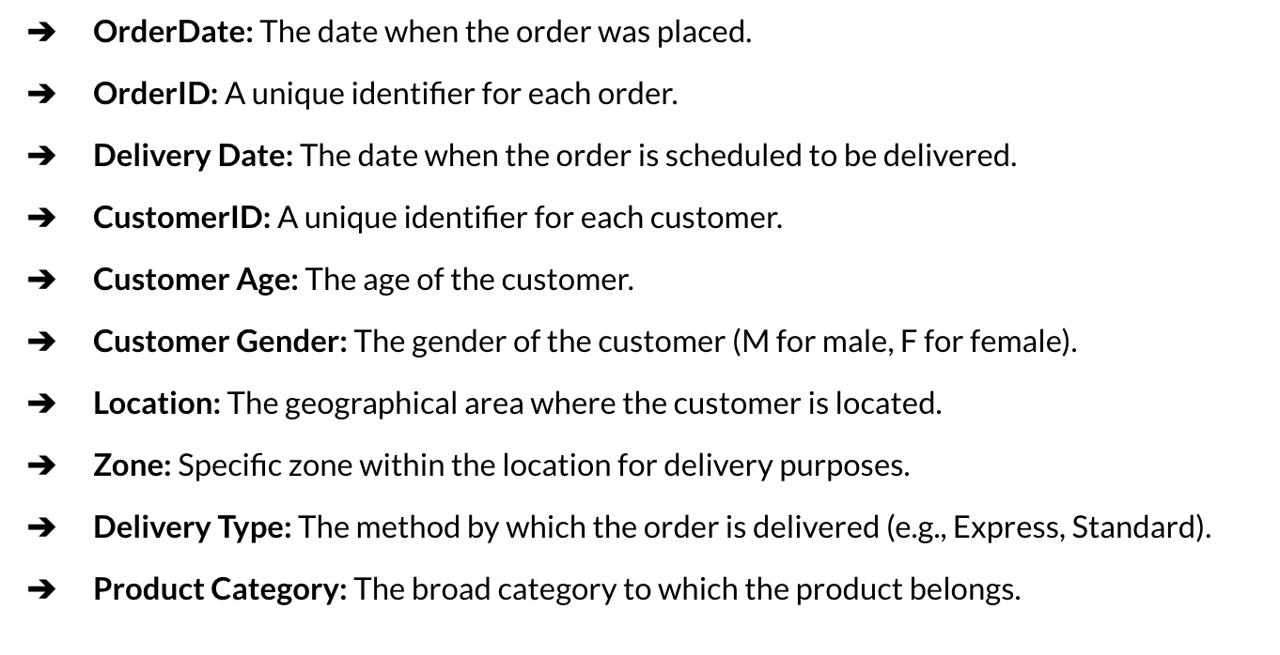
Data Description
Dataset consists of 2 Excel Worksheets named orders and customers, containing the following Attributes:

Slide 5
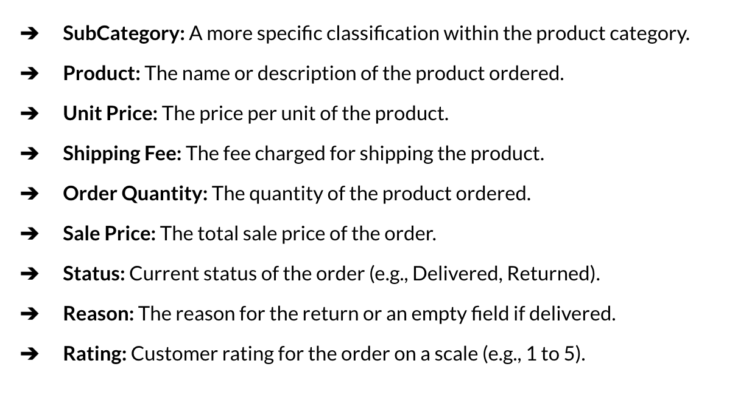
Data Description (contd..)

Slide 6
Data Cleaning & Preparation
Why It Matters: Bad data = Bad insights (Garbage In, Garbage Out) Common Data Issues
Performed missing value audit across Orders and Customers tables
Identified and corrected blank categorical values (e.g., Product Category mapping via Subcategory)
Standardized date formats and validated date consistency (OrderDate vs DeliveryDate)
Verified revenue calculation logic (UnitPrice × OrderQuantity + ShippingFee)
Conducted range validation for numeric fields (Price, Quantity, Rating)
Ensured referential integrity between Orders and Customers tables

Slide 7
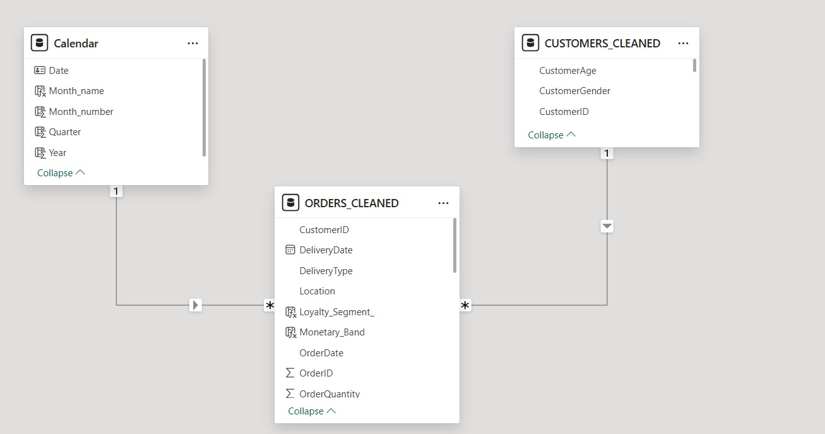
Data Modeling
Created a dedicated Date Table for time intelligence analysis
Identified Primary Key and Foreign Keys & Fact and Dimension Tables.
Established relationships between Orders and Customers & Calendar (both are one-to-many)
Built calculated columns (Wait Time, Recency Days, Loyalty Segment)
Developed DAX measures for Revenue, Rating, YoY Sales, and KPIs
Optimized data model for interactive dashboard reporting

Slide 8
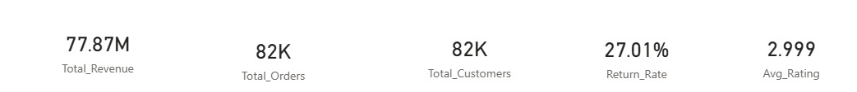
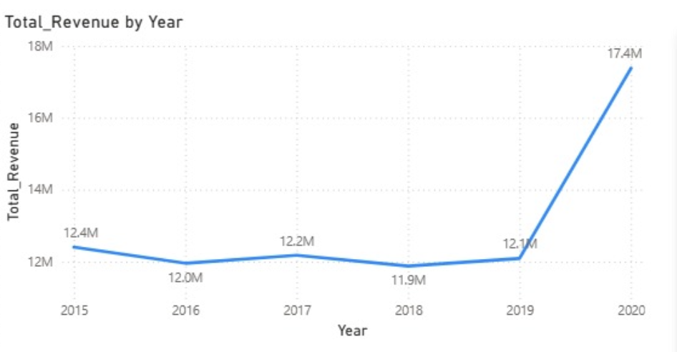
Overall Business Performance
Business demonstrated stable revenue performance with a significant growth spike in 2020.
Sales are distributed across 82K customers, indicating a broad customer base.
Despite strong revenue, the average customer rating ~3, suggesting room for experience improvement.
A 27% return rate highlights potential gaps in product satisfaction or expectation alignment.
Overall performance is strong, but operational and customer-focused optimizations are required to sustain growth.

Slide 9
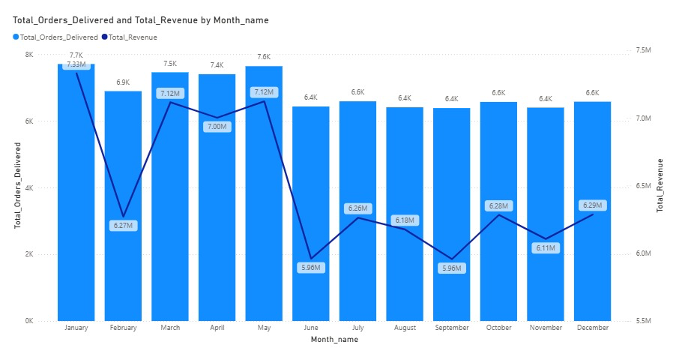
Order volumes remain stable across months, while revenue fluctuations suggest variation in average order value.
Zone 3 contributes ~43% of total revenue, indicating strong geographic concentration.
Greater Accra and Ashanti lead regional revenue performance.
Electronics and Phones & Tablets drive the majority of overall sales.
Revenue dips in June and September highlight seasonal campaign opportunities.

Slide 10
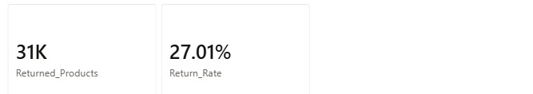
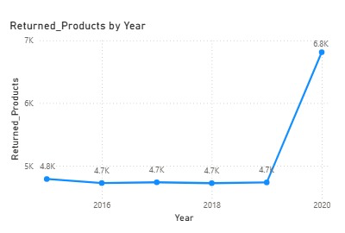
Emerging Customer Experience Risks
Despite strong revenue growth, 27% of total orders are returned, indicating a significant post-purchase issue.
Return Reasons appear to be driven by product-level gaps, but Logistics(Delivery related) issues are also high
Return volumes show a noticeable spike in 2020, aligning with the revenue surge.
~40% of orders fall under low ratings (1–2 stars), highlighting customer dissatisfaction concerns.
Average wait time remains relatively consistent across ratings, suggesting delivery speed is not the primary dissatisfaction driver.

Slide 11

Quality & Expectation Gaps Driving Returns
The top return reasons are quality defects, missing/wrong items, and product-description mismatch.
Fashion and Health & Beauty categories show the highest volume of returned products.
High return volumes are not isolated incidents but spread across key product categories.
Several high-revenue products operate with relatively low average ratings (~2.8), indicating a revenue–satisfaction gap.
The data suggests that product quality, listing accuracy, and expectation management are primary improvement areas.

Slide 12
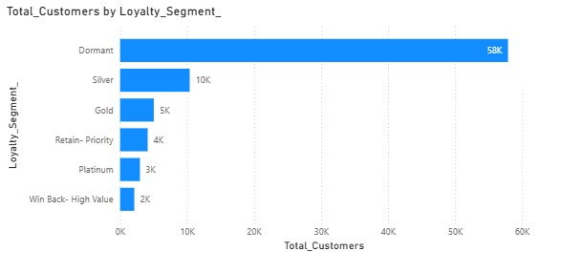
Customer Segmentation Reveals Retention Opportunity
The customer base is dominated by Dormant customers (≈58K), forming the largest segment
Dormant customers contribute ~48% of total revenue, indicating strong past value
Segments such as Platinum and Retain-Priority customers contribute significant revenue with lower customer volume.
Win-Back High-Value customers represent a strategic opportunity for targeted reactivation campaigns.
The data indicates that retention and re-engagement strategies may yield stronger returns than pure customer acquisition.

Slide 13
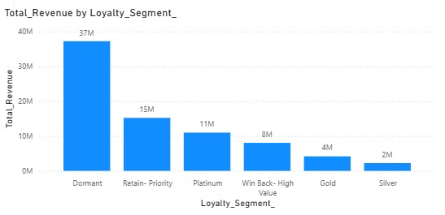
Strategy to Enhance Loyalty & Customer Experience
Targeted win-back campaigns for Dormant customers through personalized offers and re-engagement incentives.
Tier-based loyalty benefits to reward high-value and consistent customers.
Strengthen quality control to reduce returns and low ratings in key categories.
Seasonal promotional campaigns during June and September to stabilize mid-year revenue dips.
Optimize high-performing zones and regions with premium perks while diversifying growth in lower-contribution areas.
Monitor return reasons and rating patterns to proactively address product-level experience gaps.

Slide 14
Recommendations:
Strengthen product quality control and listing accuracy in high-return categories.
Structured tier-based loyalty program to reward Platinum, Gold, and Retain-Priority customers with exclusive benefits and early access perks.
Targeted win-back campaigns for Dormant and high-value inactive customers using personalized offers and limited-time incentives.
Category-specific improvement initiatives in Fashion and Health & Beauty to address return drivers such as defects and expectation mismatch.
Deploy seasonal promotional campaigns in low-performing months (June and September) to stabilize revenue volatility.
Diversify regional growth by expanding marketing efforts beyond high-concentration zones while protecting high-performing locations.

Slide 15

Report- Main Tab

Slide 16
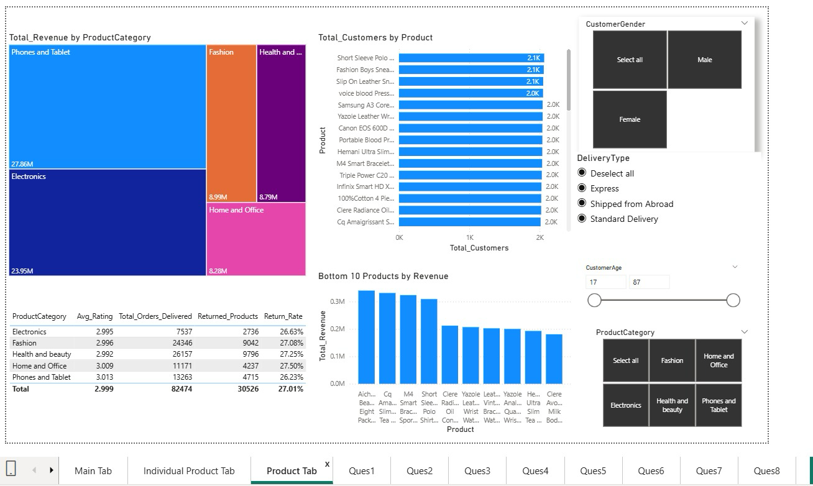
Report- Product Tab

Slide 17
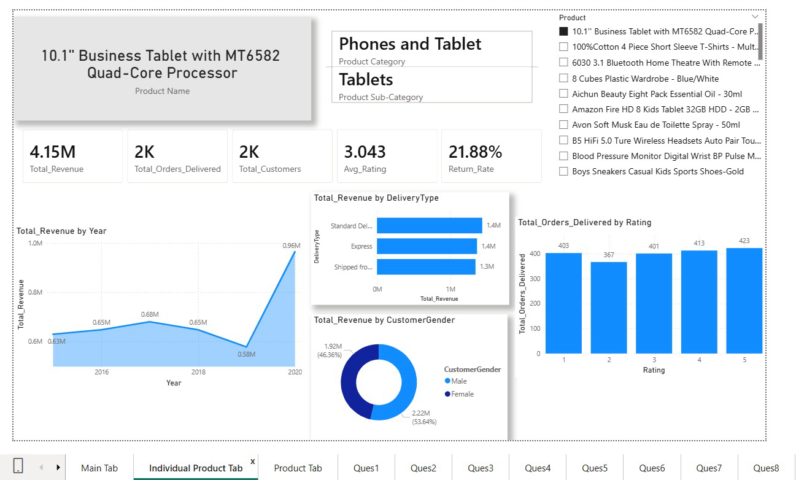
Report- Individual Product Tab

Slide 18
Conclusion
The company demonstrates strong revenue growth and stable demand, indicating a solid performance.
However, high return rates and low customer ratings highlight underlying experience gaps that require immediate attention.
Revenue concentration across specific zones, products, customer segments increases strategic exposure risk.
Customer segmentation reveals significant retention and re-engagement opportunities, particularly among Dormant and high-value customers.
By combining quality improvement, targeted loyalty programs, and data-driven promotional strategies, the company can strengthen long-term customer relationships while sustaining growth momentum.

